Slide 1

LENDING CLUB CASE STUDY
Deepak Mohanta
Mahak Porwal

Slide 2
TABLE OF CONTENTS
01.
Data cleaning
PROBLEM VS SOLUTION
Add a short description
Data cleaning
02.
PRODUCT
Add a short description
Data cleaning
03.
MARKET & TREND
Data cleaning
Add a short description
04.
BUSINESS MODEL
Data cleaning
Add a short description

Slide 3

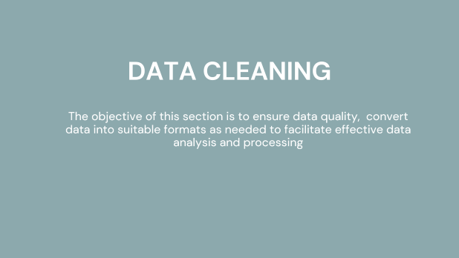
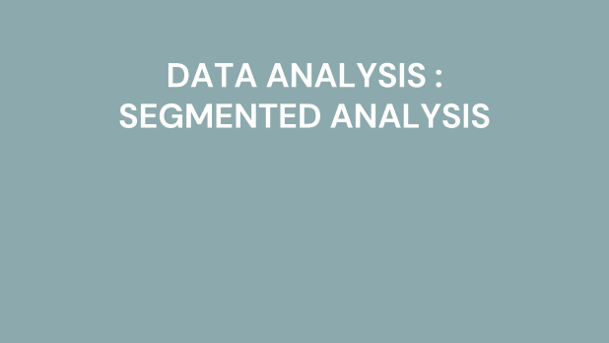
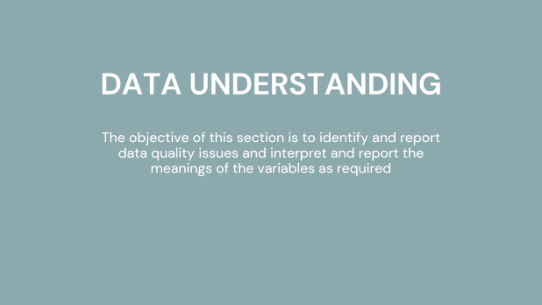
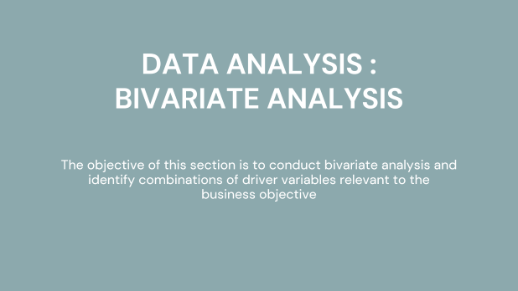
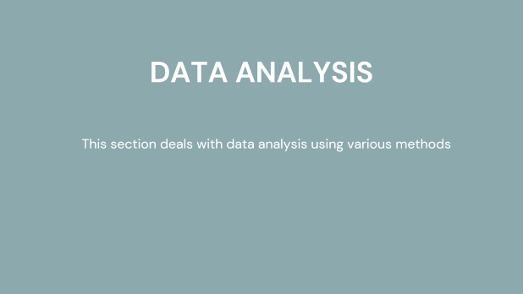
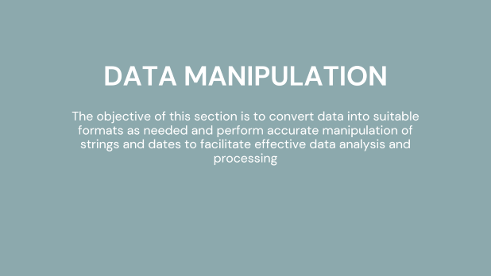
SLIDE SUMMARY

Slide 4
DATA UNDERSTANDING
The objective of this section is to identify and report data quality issues and interpret and report the meanings of the variables as required

Slide 5
BUSINESS OBJECTIVE & DATA UNDERSTANDING
We are given a loan dataset from year 2007 to 2011 covering the details of all loan applicants.
The objective is to identity the loan or customer attributes which could become or are a driving factor in predicting whether a loan application can become defaulter.
All the attributes mentioned in the loan dataset can be understood with the help of Data Dictionary.
The Loan Status attribute would be our pivot henceforth. It is categorized as Fully Paid, Current and Charged Off. Here "Charged Off" delegates to defaulters who would have either refused to pay or ran away with the money owed.
Data understanding and objective
Data Quality and data manipulation
Univariate analysis
Bivariate analysis
Segmented analysis
Observations & Conclusions

Slide 6
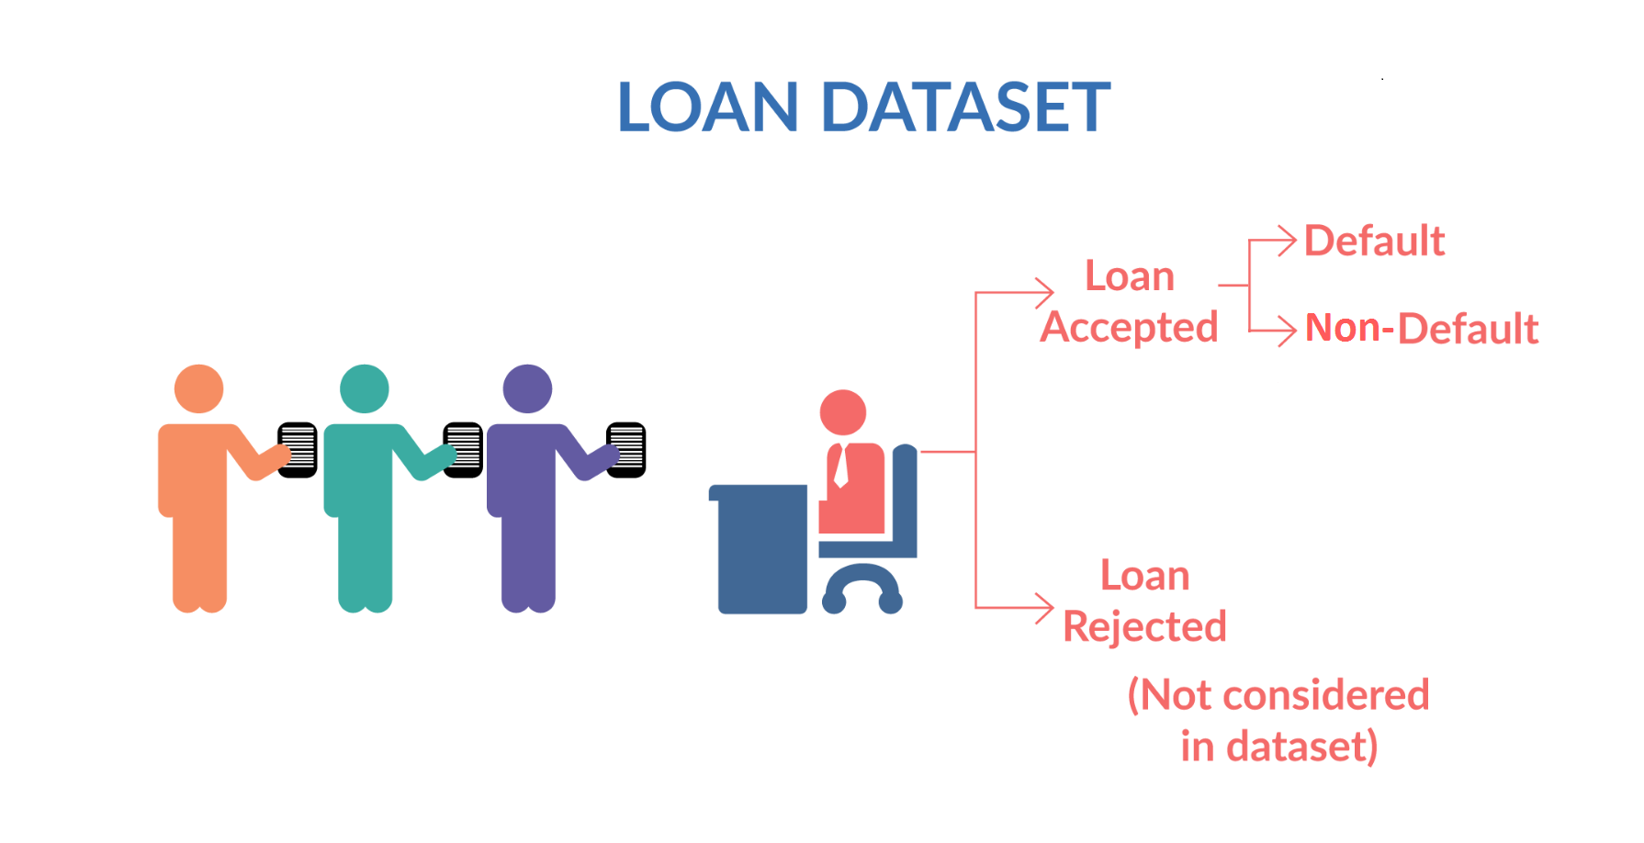
BUSINESS OBJECTIVE & DATA UNDERSTANDING

Slide 7
DATA QUALITY ISSUES OBSERVED
For this assignment, we have diligently conducted a comprehensive data quality assessment using a well-structured checklist. We systematically evaluated each column, applying a consistent set of methods and criteria. Our meticulous process involved a thorough examination of each column's data quality, and our observations and findings have been meticulously documented on the subsequent slides for your review.

Slide 8
DATA QUALITY ISSUES OBSERVED

Slide 9
DATA CLEANING
The objective of this section is to ensure data quality, convert data into suitable formats as needed to facilitate effective data analysis and processing

Slide 10
SUMMARY DATA CLEANING
Missing Data Identification:
Uncovered rows or columns with missing values.
Discovered rows or columns with over 50% of their values as null.
Uniformity Observation:
Identified columns with uniform values across all rows.
Recognized columns that provide no analytical value and can be excluded from further analysis.
Redundant and Unique Columns:
Detected columns with redundant or unique information, such as "title," "url," "desc," etc., which may not contribute to the analysis goals.

Slide 11
DATA CLEANING
The following list of columns contains only ‘NA’ as cell value.
These columns are not included in the current analysis.

Slide 12
DATA CLEANING
The following columns are not included in the analysis.
Few of the columns contained very insignificant number of NA values
On the other hand, other columns contain unstructured text. To keep the analysis simple, we have not included this column in our analysis.
There are four columns which contains only single value which were also not included in the current analysis

Slide 13
DATA MANIPULATION
The objective of this section is to convert data into suitable formats as needed and perform accurate manipulation of strings and dates to facilitate effective data analysis and processing

Slide 14
DATA MANIPULATION
Extracted year and month information from the existing date column.
Why is this required ? This is required to check whether there is a significant influence of year and month data on the default rate.
Removed % from Interest Rate(int_rate) and Revolving Utilization(revol_util).
Manupulated emp_length to have just digits and filled the blank values with 0.
Filled pub_rec_bankruptcies column blank values with Not Known.

Slide 15
DERIVED COLUMNS
Extracted month and year date from the following columns
last_credit_pull_d
last_pymnt_d
earliest_cr_line
issue_d
Created Bins for the following columns
loan_amnt
annual_inc
int_rate
dti_categories

Slide 16
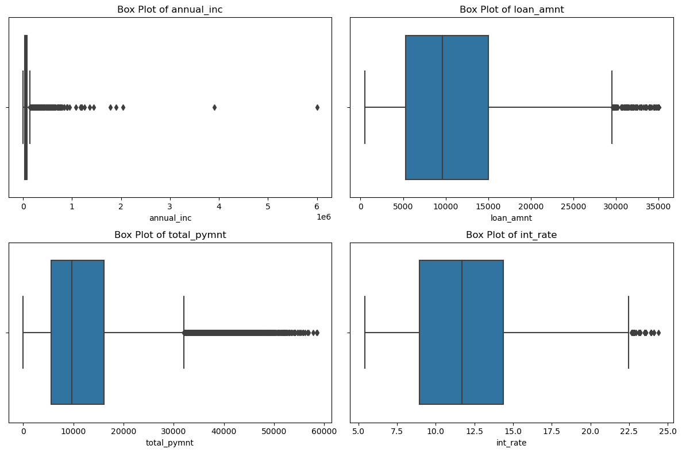
DATA MANIPULATION : OUTLIER IDENTIFICATION
List of columns for which the outliers analysis was done
annual_inc
loan_amnt
total_pymnt
int_rate
Step - 1: Plot box plots to see if outliers exist or not
Step - 2: If outliers exist then remove those outliers
Observation/s and insight/s
The box plot clearly shows that there are outliers present in the the data sets

Slide 17
DATA ANALYSIS
This section deals with data analysis using various methods

Slide 18
DATA ANALYSIS : UNIVARIATE & SEGMENTED UNIVARIATE
The objective of this section is to conduct univariate and segmented univariate analyses and identify 5 critical driver variables

Slide 19
DATA MANIPULATION : OUTLIER IDENTIFICATION
Observation/s and insight/s. I have gone through the above plots to extract meaningful insights. The observations are captured below.
Highest number of loans are distributed loans have the ticket size in between 9900-10500.
77.9% loans distributed have term of 36 months
The highest number of LC assigned loan grade are in B category
The highest Job titles belong to US Army and Bank of America
More than 80% of borrowers have either rent or mortgaged their home.
While 85% have fully paid their loans but 15% have singed off loan status.
46% of borrowers stated debt consolidation as the purpose of taking loan the second category represents 13% stated credit card as purpose.
945xx - Zip code represents the highest number of borrowers
17.9% borrowers stated CA as their state

Slide 20
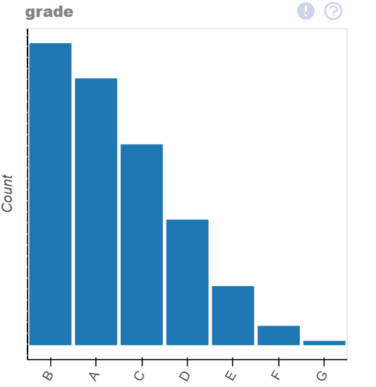
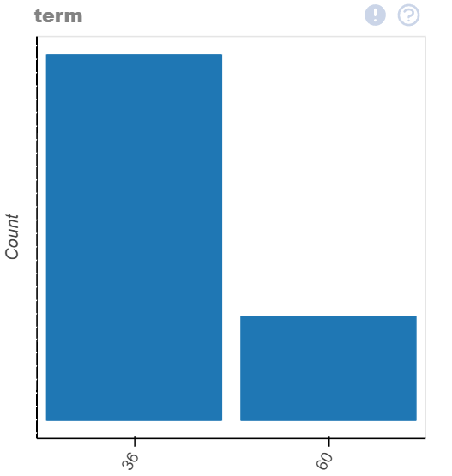
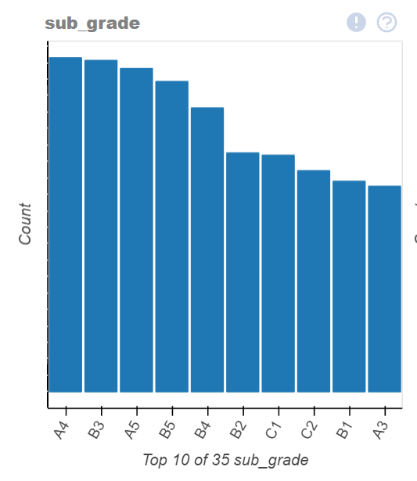
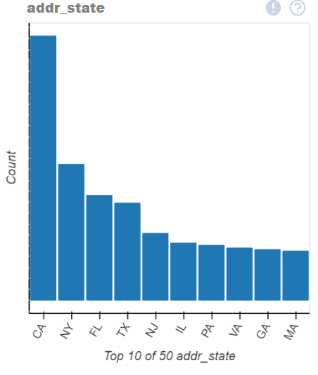
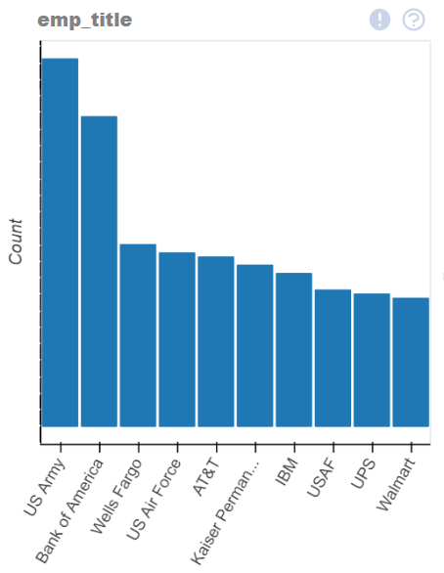
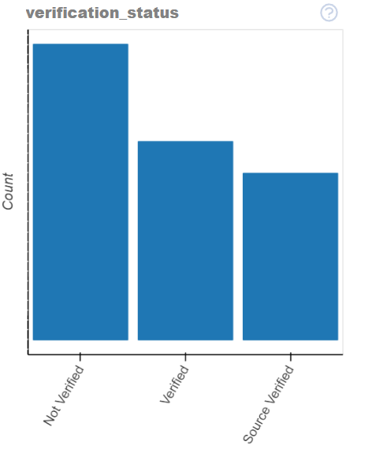
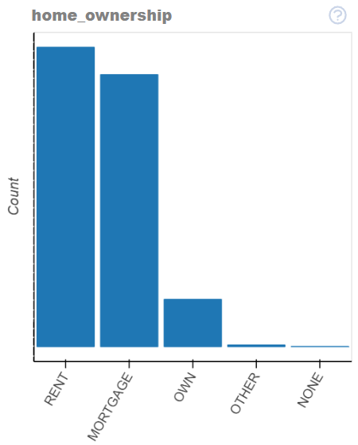
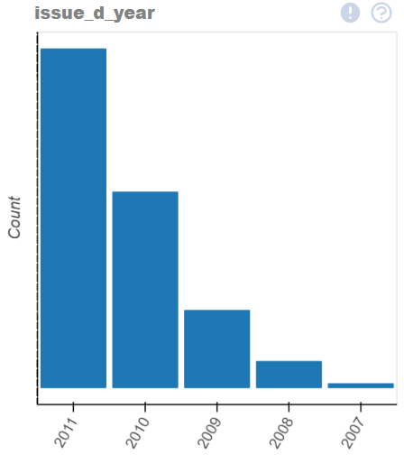
UNIVARIATE ANALYSIS

Slide 21
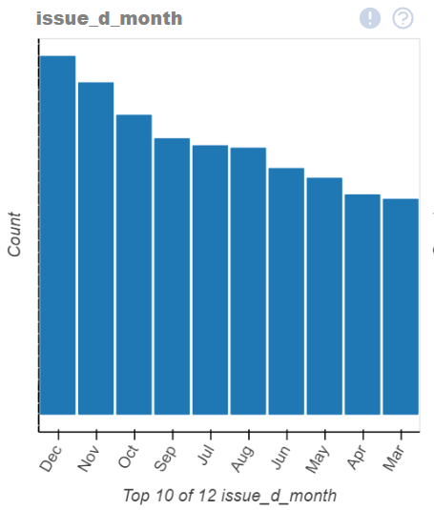
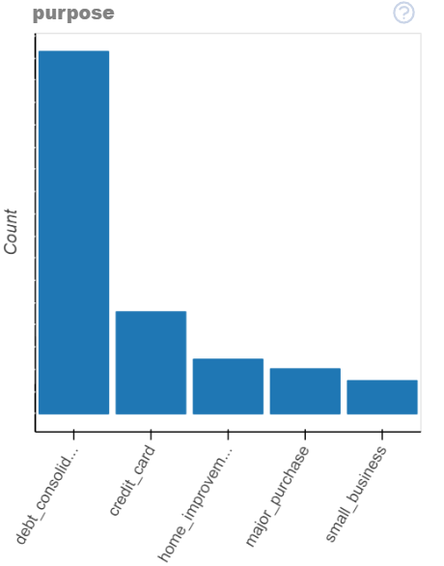
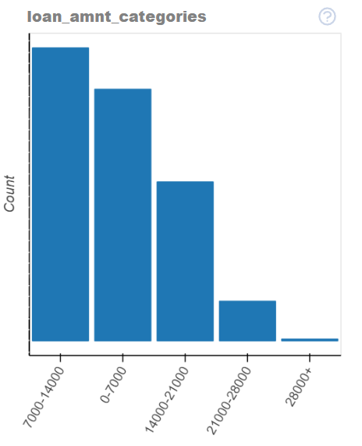
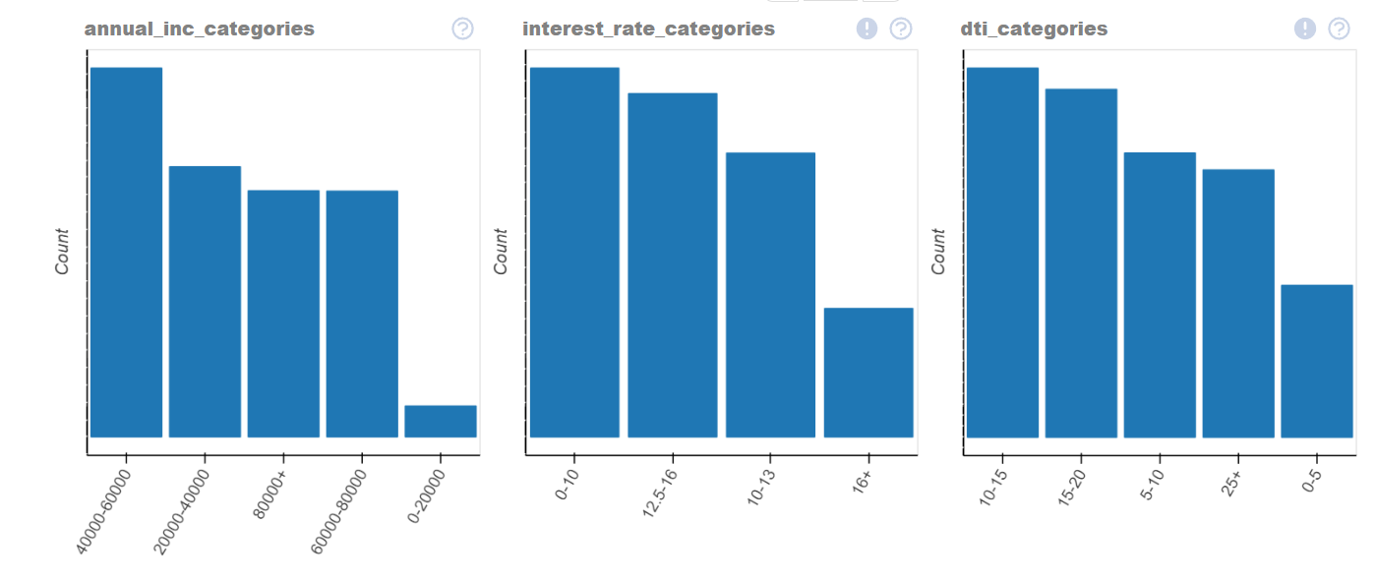
UNIVARIATE ANALYSIS

Slide 22
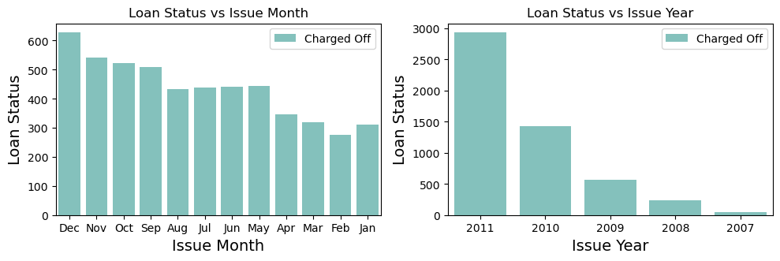
UNIVARIATE ANALYSIS : CHARGED OFFS VS M/Y
Charged off loans are mostly issued in the last quarter of the year.
highest number of charged off loans are issued in 2011. There is a stead increase in the charged off loans year after year.

Slide 23
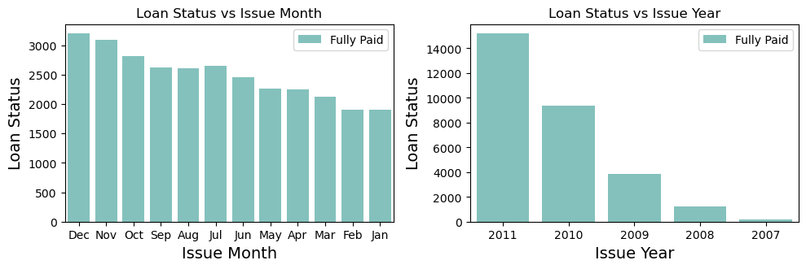
UNIVARIATE ANALYSIS : FULLY PAID VS M/Y
Fully paid loans are mostly issued in the last quarter of the year.
highest number of charged off loans are issued in 2011. There is a stead increase in the charged off loans year after year.
No solid conclusion/s can be made since both fully paid and charged off loans have similar characteristics.

Slide 24
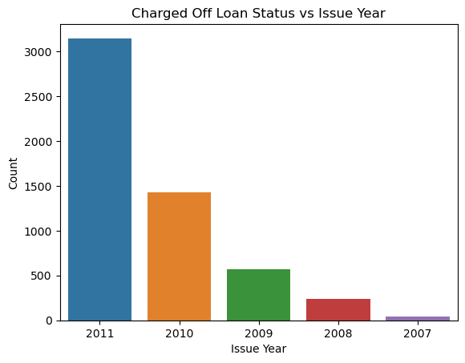
UNIVARIATE ANALYSIS : CHARGED OFFS VS ISSUE YEAR
Observation: 2011 year observed major charged offs applicants

Slide 25
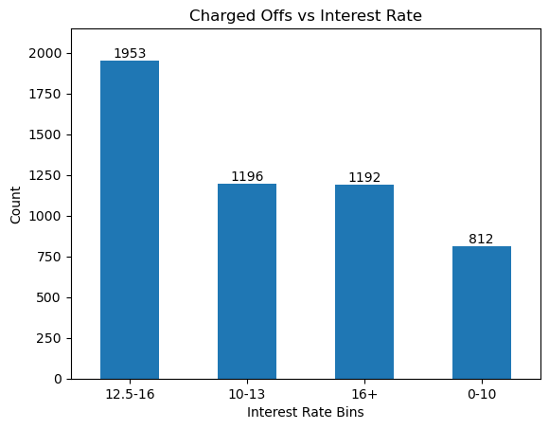
UNIVARIATE ANALYSIS : CHARGED OFFS VS INTEREST RATE
Observation: Major Charge Offs are seen with Interest rate 12.5 to 16 percentage.

Slide 26
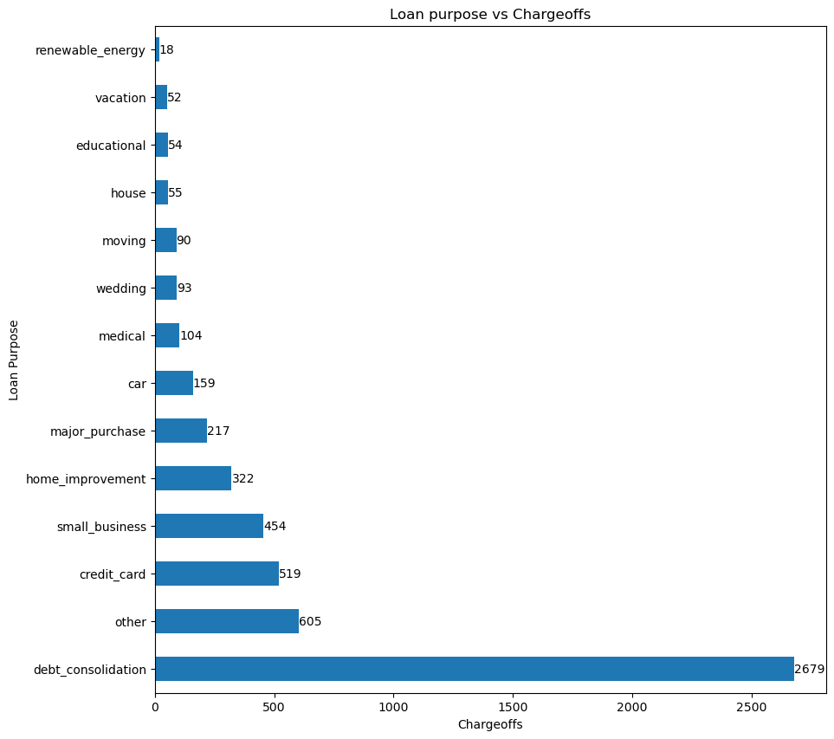
UNIVARIATE ANALYSIS: CHARGED OFFS VS PURPOSE
Observation: Major Charge Offs are observed with Applicants with Purpose Debt Consolidation

Slide 27
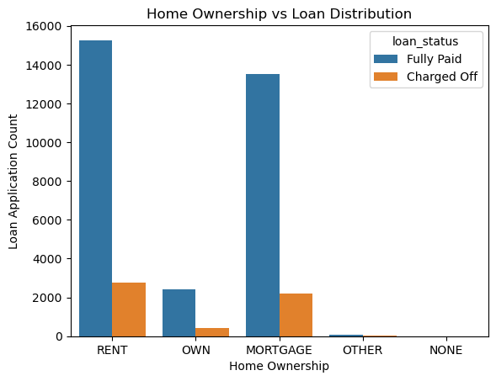
UNIVARIATE ANALYSIS : Charged Offs vs Home Ownership
Observation: Major Charge Offs are seen with Rented and Mortgaged Ownership Applicants

Slide 28
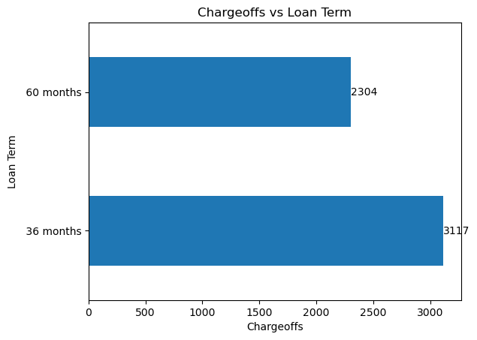
UNIVARIATE ANALYSIS : CHARGED OFFS VS TERM
Observation: Major Charge Offs are seen with Applicants taking 36 Months as the loan term

Slide 29
DATA ANALYSIS : BIVARIATE ANALYSIS
The objective of this section is to conduct bivariate analysis and identify combinations of driver variables relevant to the business objective

Slide 30
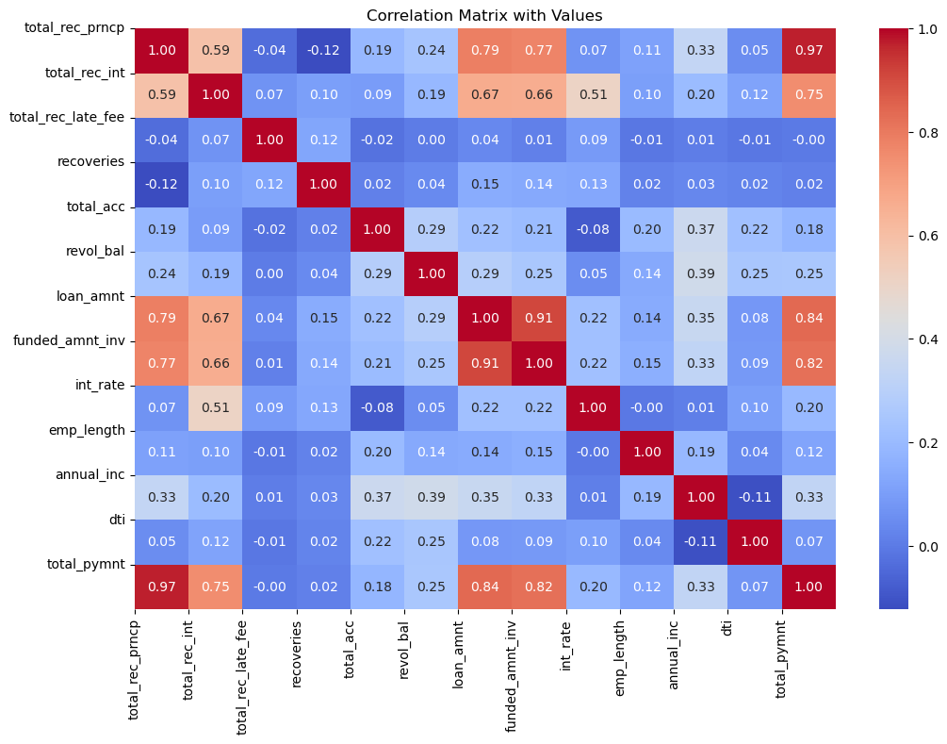
BIVARIATE ANALYSIS : CORRELATION MATRIX
Obsevation/s and insight/s
Positive correlation is observed between principal received to date an interest received to date, loan amount, funded amount by investros and total payment. This is expected
There is negetive correlation between principal received to date with late fees received to date & recoveries
This means when late fees and recoveries decreases principal received will increase
When loan amount is high toal interest received is also high. High ticket loans are briningin in more interest to the business.
Interestingly the number of accounts/credit lines by borrower is negetively correlated to late fees received to date and interest rate.
This means borrowers with higher number of multiple accounts are able to manage their credit better as compared to borrowers with less number of accounts.
When funded amount by investors goes up loan amount also goes up.
Interest rate is lesser for employees having longer employement.
Total late fees received to date decreases as employement length increases
Annual income is negetively correlated to debt to income ratio.

Slide 31
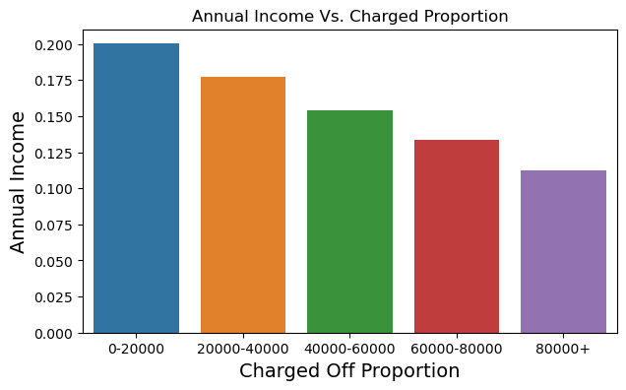
BIVARIATE ANALYSIS : CHARGED OFF LOAN CATEGORY
Income range 0-20000 has the highest chances of being charged off.

Slide 32
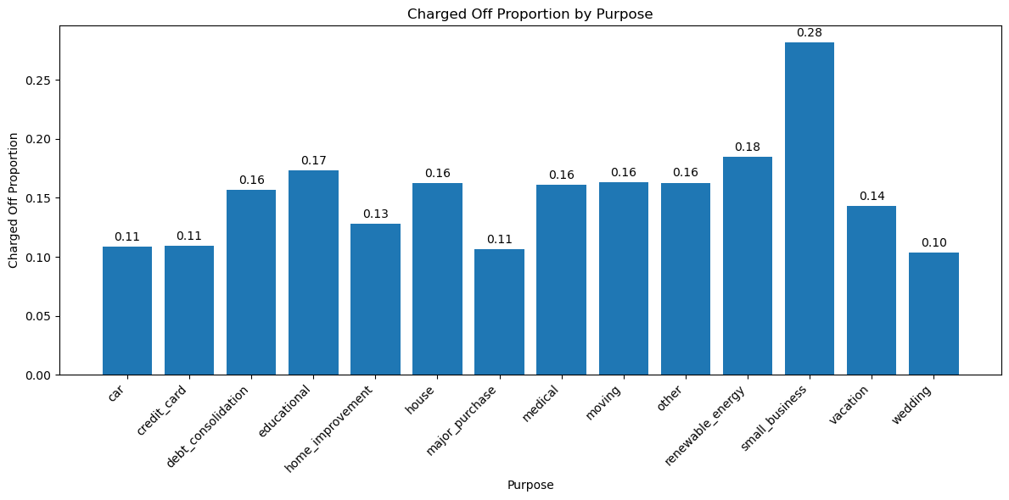
BIVARIATE ANALYSIS : CHARGED OFF LOAN vs. PURPOSE
Top three purpose leading to charge off
Small business
Renewable energy
Educational

Slide 33
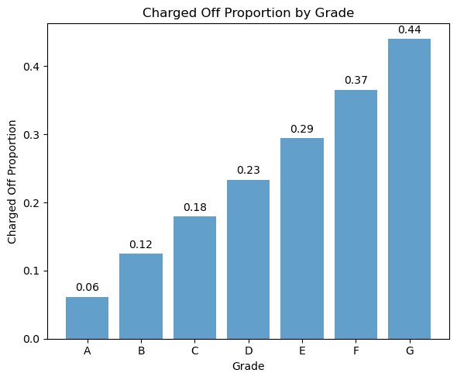
BIVARIATE ANALYSIS : CHARGED OFF LOAN VS. GRADE
Grade A borrowers have the lowest likelihood of experiencing charge-offs.
Conversely, Grade F and Grade G borrowers face a significantly higher risk of charge-offs.
The probability of charge-offs appears to increase as you progress from Grade A to Grade G.

Slide 34
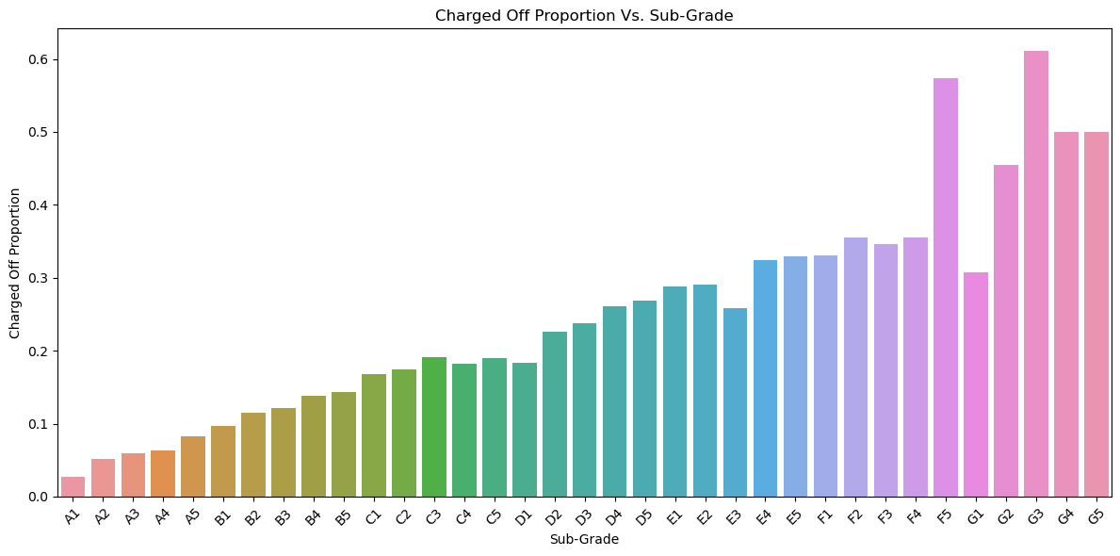
BIVARIATE ANALYSIS : CHARGED OFF LOAN VS. SUB-GRADE
Sub-Grade A1 exhibits the lowest likelihood of experiencing charge-offs.
Conversely, Sub-Grades F5 and G3 are associated with a significantly higher risk of charge-offs.

Slide 35
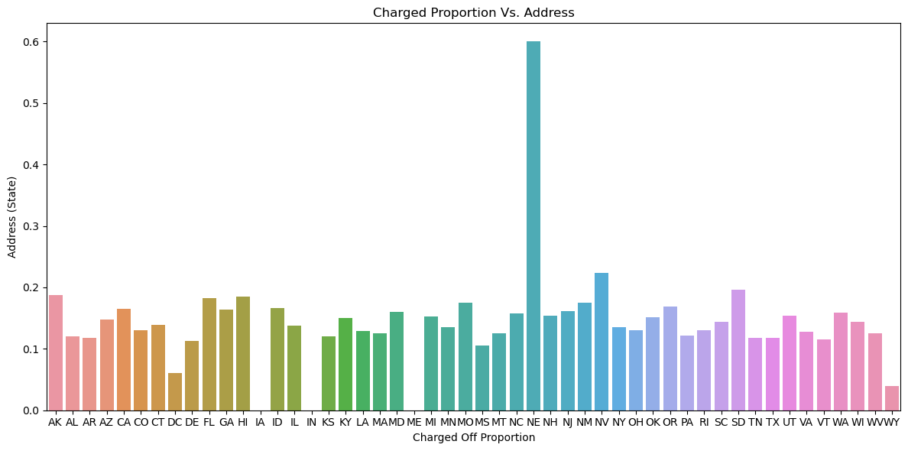
BIVARIATE ANALYSIS : CHARGED OFF LOAN VS. SUB-GRADE
The state of NE exhibits a very high likelihood of charge-offs, but the number of loan applications from this state is insufficient to draw meaningful conclusions.
On the other hand, states like NV, CA, and FL show a substantial number of charge-offs across a significant volume of loan applications, indicating a noteworthy trend of charge-offs in these regions.

Slide 36
DATA ANALYSIS : SEGMENTED ANALYSIS

Slide 37
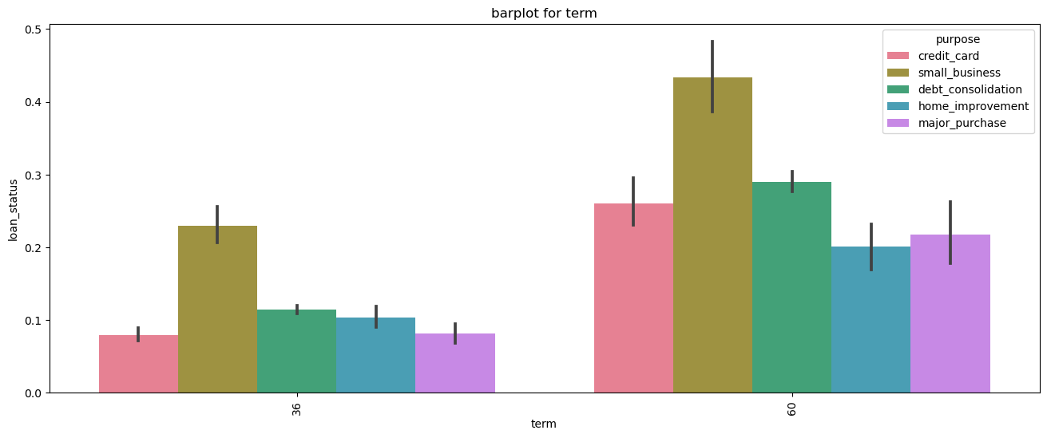
SEGMENTED ANALYSIS : LOAN STATUS, TERM, PURPOSE
Small business has the most loans defualts, followed by debt_consolidation for both terms.

Slide 38
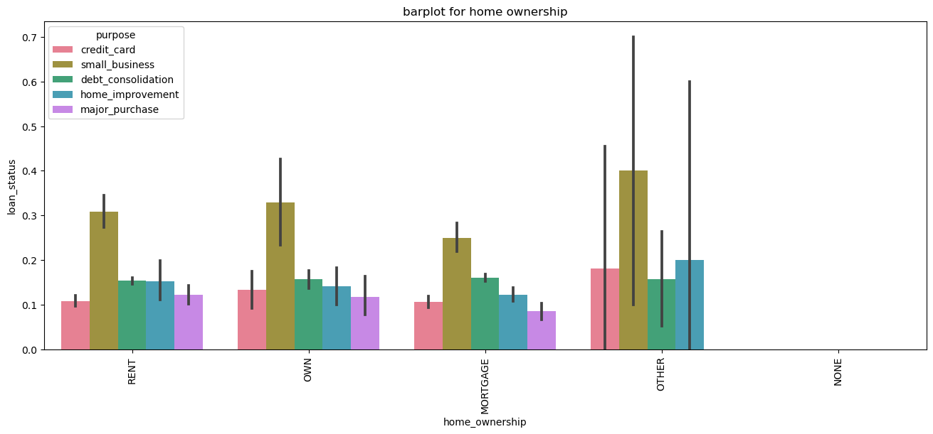
SEGMENTED ANALYSIS : LOAN STATUS, HOME OWNERSHIP, PURPOSE
Small business has the most loans defaults across home ownership segment.

Slide 39
RECOMMENDATIONS

Slide 40
RECOMMENDATIONS
Based on the observations you've made from your data analysis, here are some recommendations and insights:
Small Business Loans: Since most defaulters are observed to be taking loans for small business purposes, it may be advisable for lenders to implement stricter screening criteria for applicants seeking loans for small businesses. This could include a more thorough assessment of the business plan and financial stability of the business.
Higher Annual Income: The data shows that defaulters tend to have lower annual incomes. Lenders could consider setting minimum income thresholds for loan applicants to reduce the risk of default. Additionally, offering financial literacy resources to help borrowers manage their finances could be beneficial.
Grade G and F Loans: Lenders should be cautious when approving loans with Grade G and F, as these grades are associated with higher default rates. It may be wise to limit the issuance of such loans or charge higher interest rates to compensate for the increased risk.
Higher Interest Rates: Defaulters are more likely to have loans with interest rates greater than 16%. Lenders should be cautious about extending loans with very high-interest rates, as this may make it difficult for borrowers to meet their repayment obligations. Proper assessment of the borrower's ability to repay at such rates is crucial.
Economic Crisis Impact: The observation that most defaulters are from the year 2011, which was a recession year, highlights the impact of economic crises on loan defaults. Lenders should consider macroeconomic factors and market conditions when assessing loan applications during economic downturns.
Loan Term: Defaulters are more common among loans with a 36-month term. Lenders might consider offering shorter-term loans or closely monitoring loans with longer terms to mitigate the risk of default.
Experience Level: Borrowers with no years of experience are more likely to default. Lenders should assess the stability and income potential of borrowers with limited work experience more rigorously.
Bankruptcy Records: Borrowers with public bankruptcy records are at a higher risk of default. Lenders should exercise caution when dealing with applicants who have a history of bankruptcy and may implement stricter eligibility criteria or charge higher interest rates to mitigate the risk.

Slide 41
RECOMMENDATIONS
In summary, the data analysis suggests that lenders should focus on improving their risk assessment and monitoring processes, especially for loan applicants seeking funds for small businesses, those with lower income, poor credit grades, high-interest rates, limited experience, and a history of bankruptcy. Additionally, being aware of economic conditions and their potential impact on default rates is essential for prudent lending practices

Slide 42
THANK YOU
Have any question?

